Slide 1
MEMEFLIX
A Journey Down Memory Lane with Meme Videos
Notes:
Contributors
technical barriers
interesting challenges
mockups screenshots
Demo
exploring meme culture through a virtual keyboard triggering random classic YouTube meme videos.

Slide 2
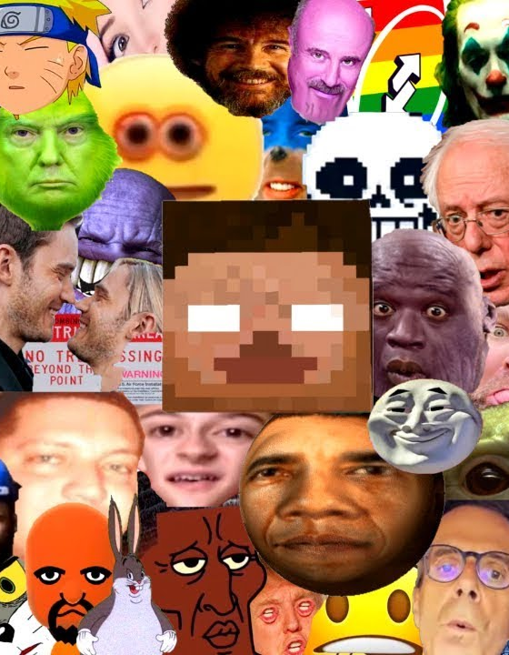
Overview
Purpose: exploring meme culture through a virtual keyboard triggering random classic YouTube meme videos.
Design: Features a vintage computer screen that will play a classic YouTube meme video and a virtual keyboard allowing users to click on letters from A to Z
Technologies used: HTML, CSS, JavaScript, YouTube API

Slide 3
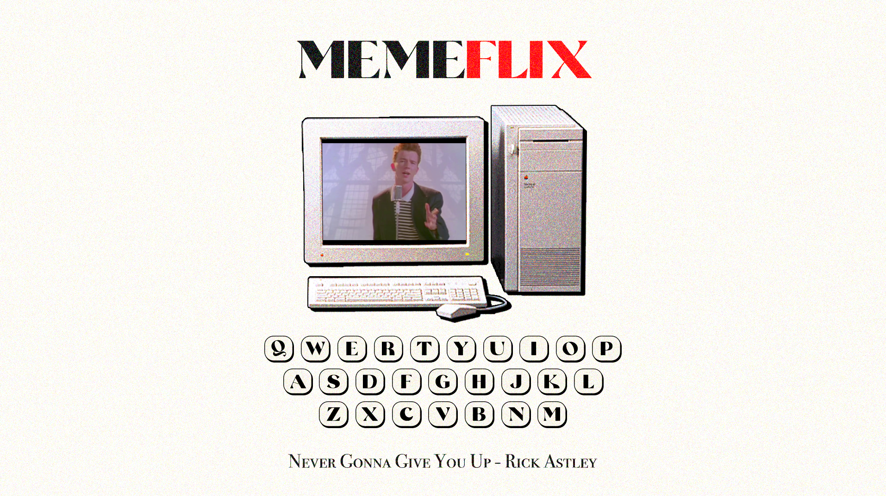
Original Mock Up

Slide 4

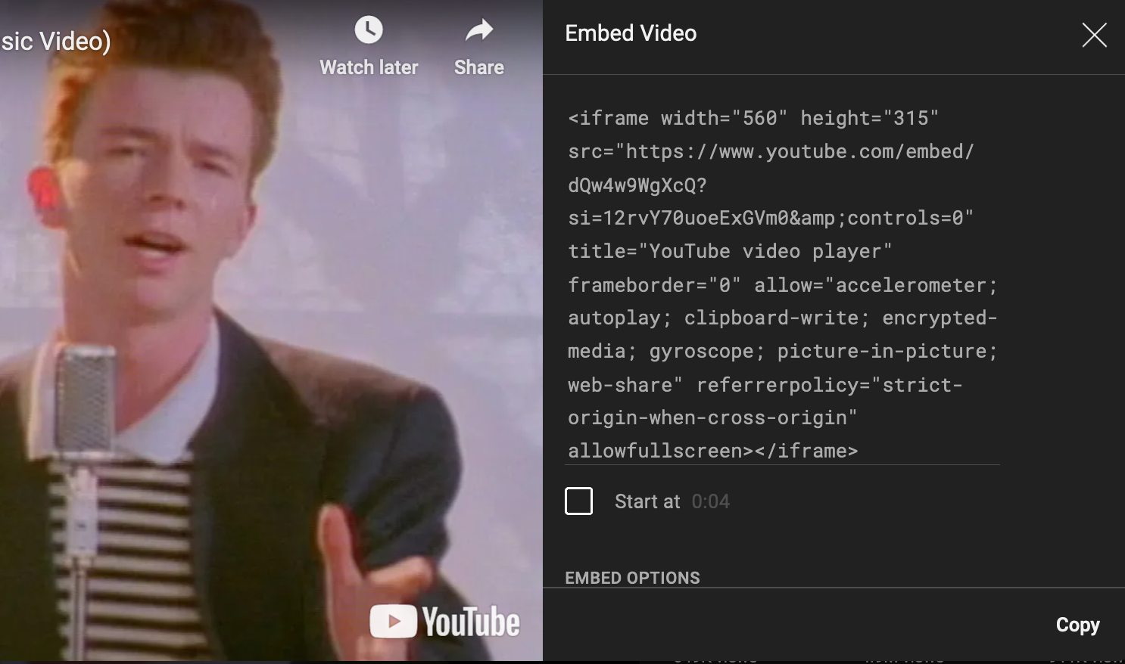
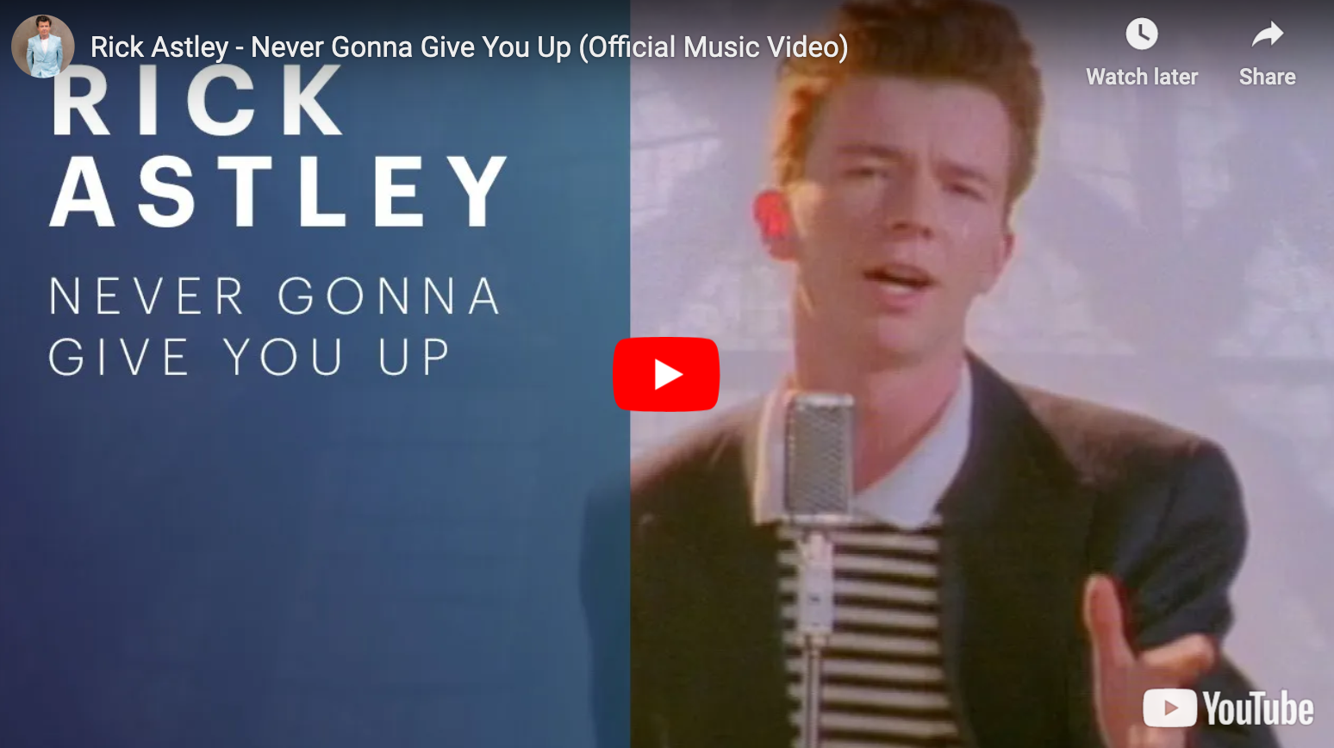
Technical Challenges
Prevention of Redirection
AutoPlay Constraints
Custom Embedding Limitations
Avoid users from being redirected to YouTube by placing a transparent overlay on top of the iframe.
Auto playing with sound is restricted by browsers
Utilized the YouTube API’s to manually triggered the video to unmute and play.
The option to embed YouTube videos without titles or logos was deprecated

Slide 5
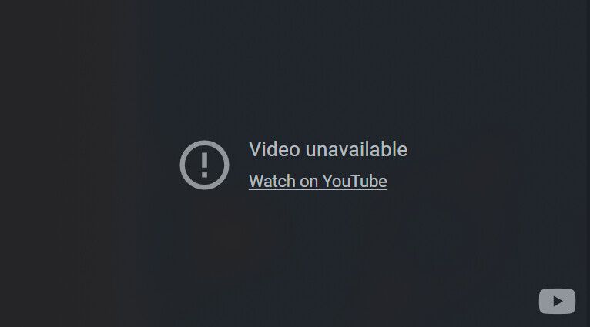
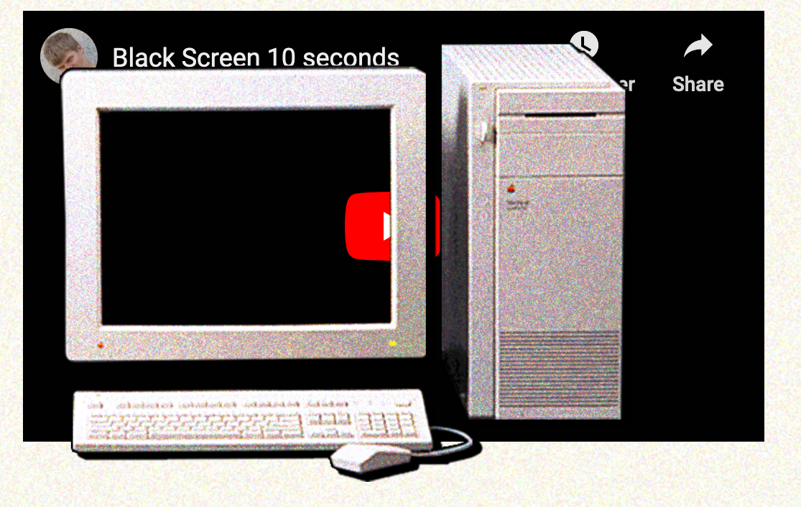
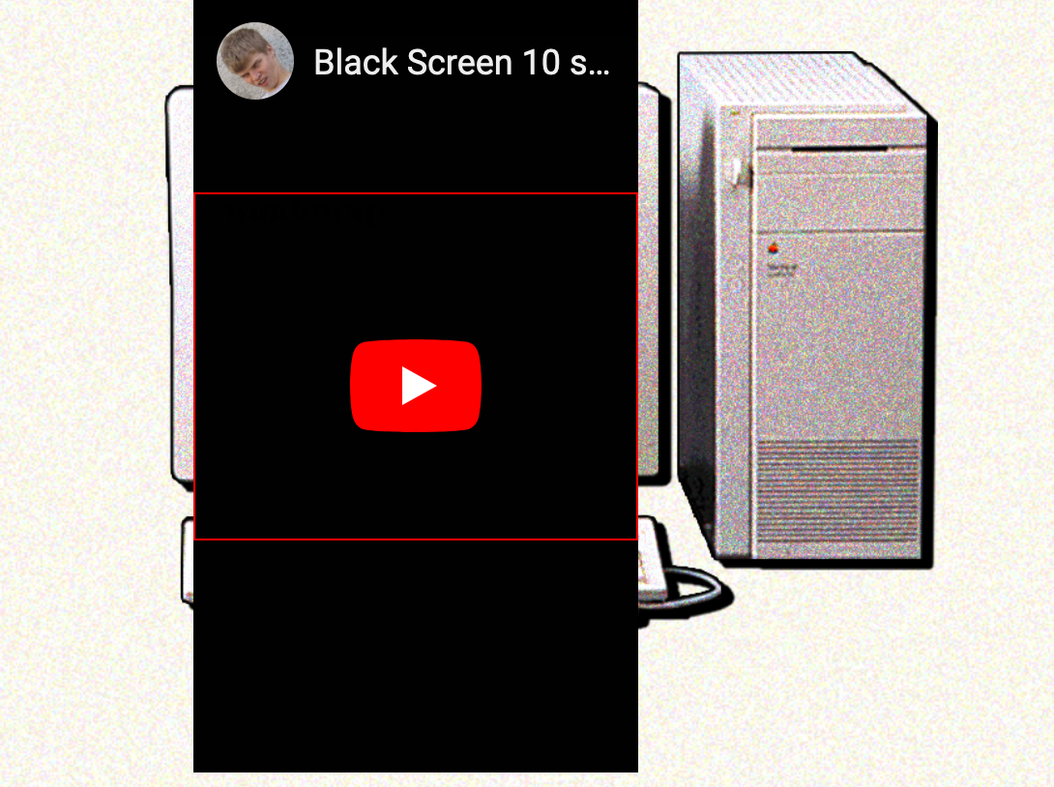
Interesting Challenges
Embedding Restrictions
CSS Customization
Utilize CSS to hide video elements
Layering Elements
Match YouTube dimensions to the retro computer screen design
Limitations on embedding copyrighted music. Shifted to include meme videos

Slide 6
DEMO

